Slide 1
Expansion Analysis Insights
File created on: 9/14/2022 1:27:43 PM

Slide 2
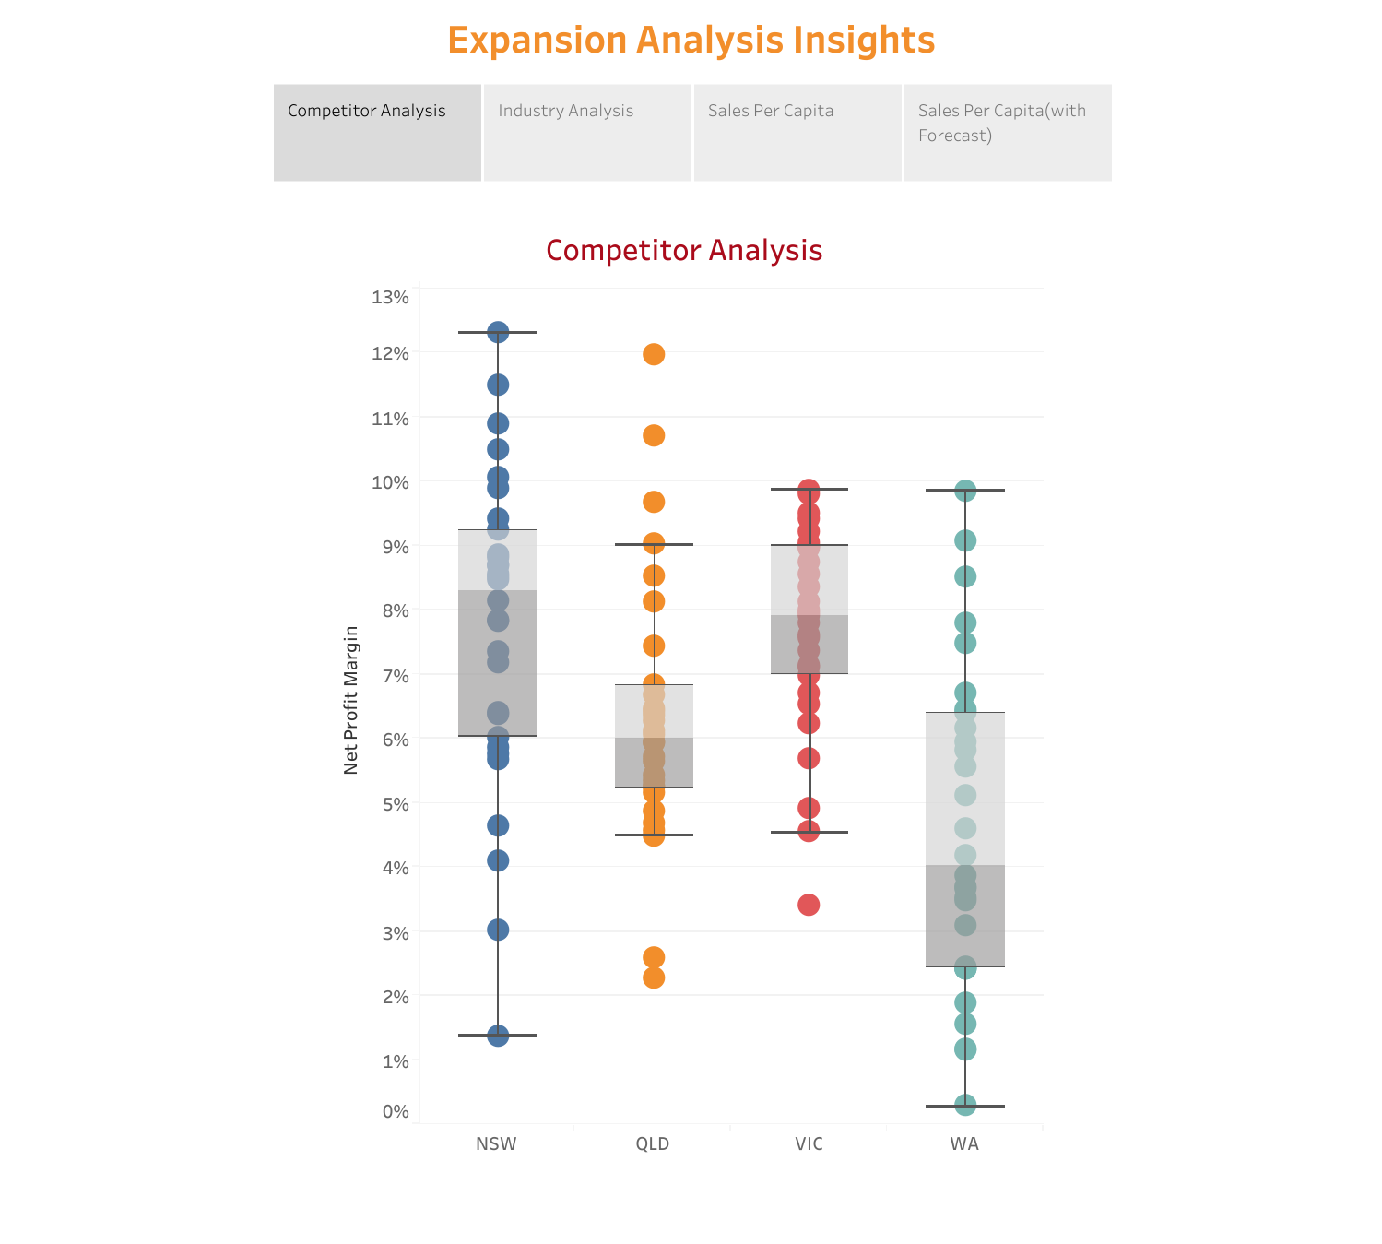

Slide 3
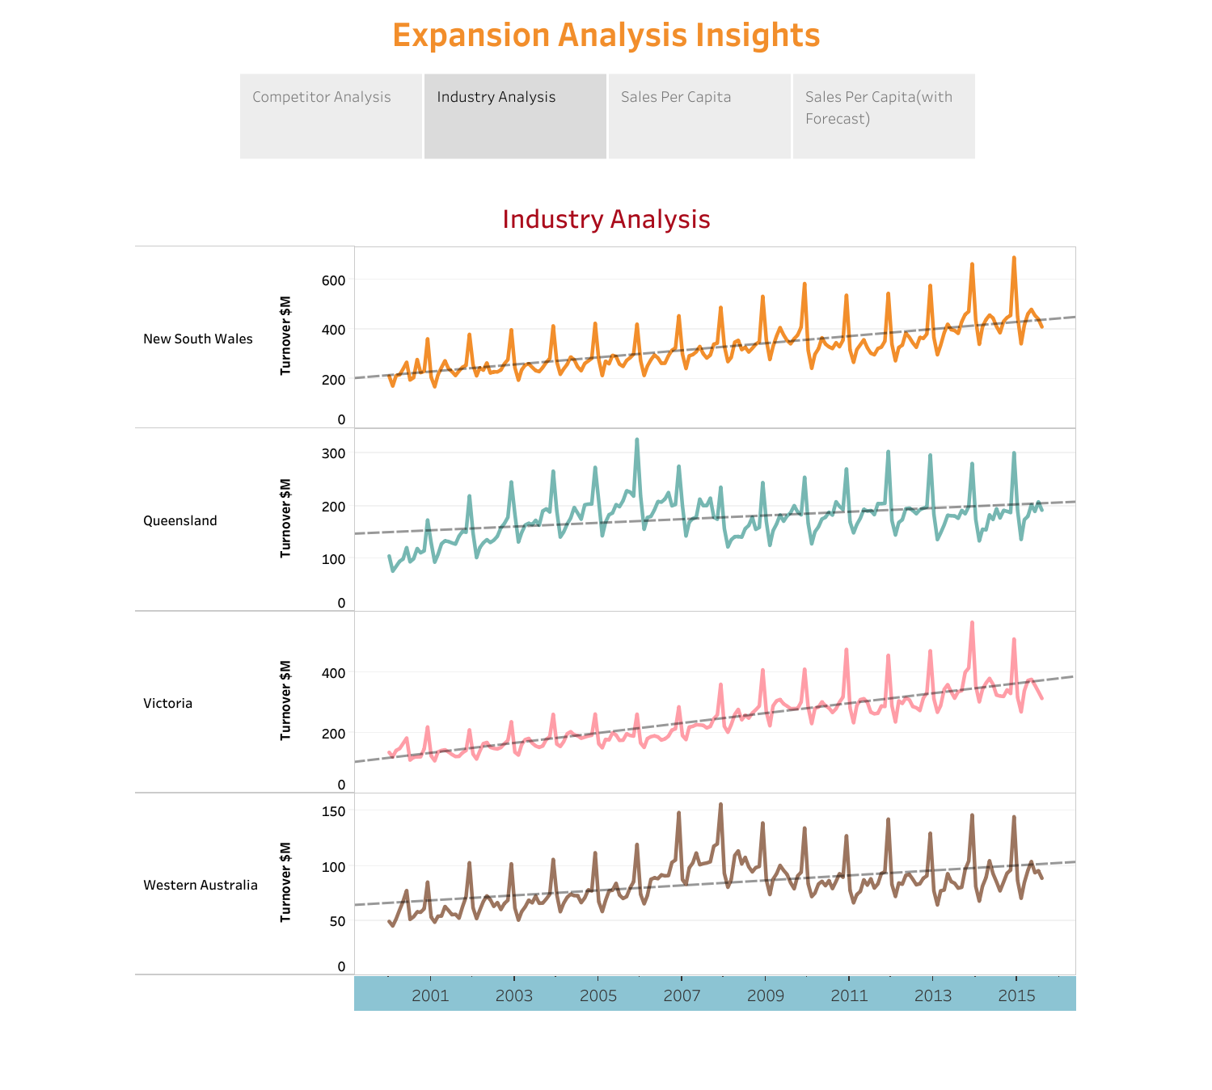

Slide 4
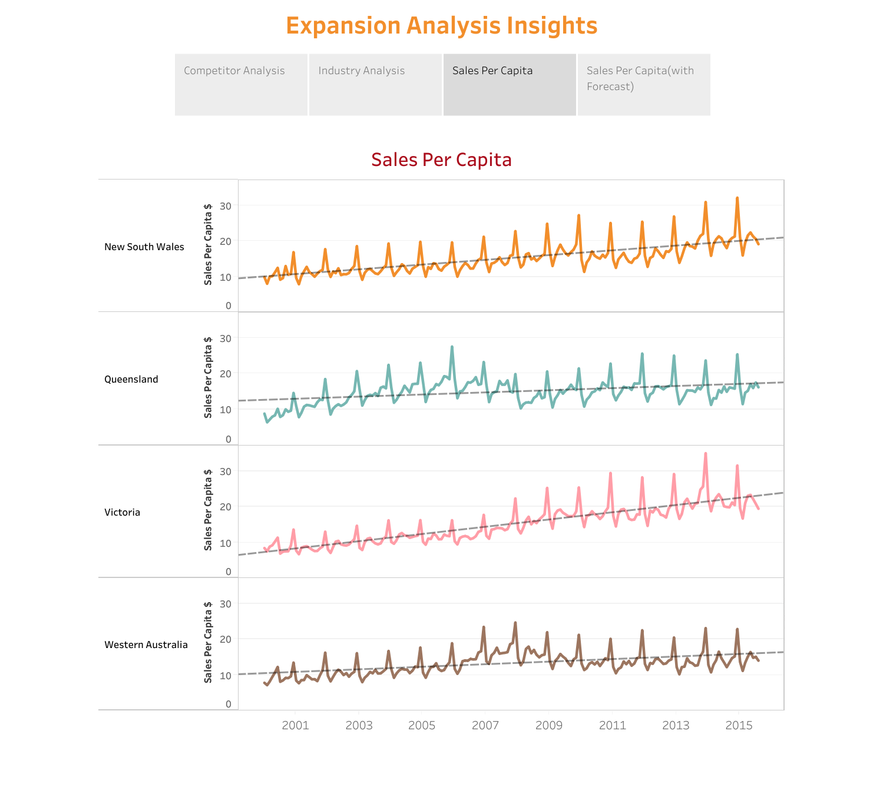

Slide 5
